Slide 1
Global Magnetic Field Modeling

Slide 2
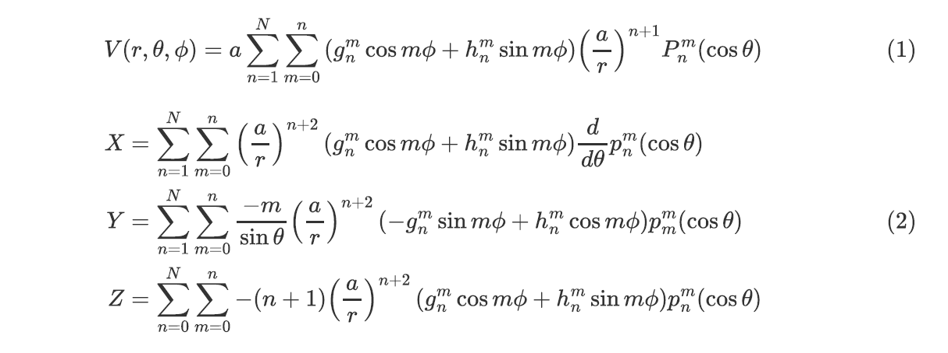
Methods and data

Slide 3
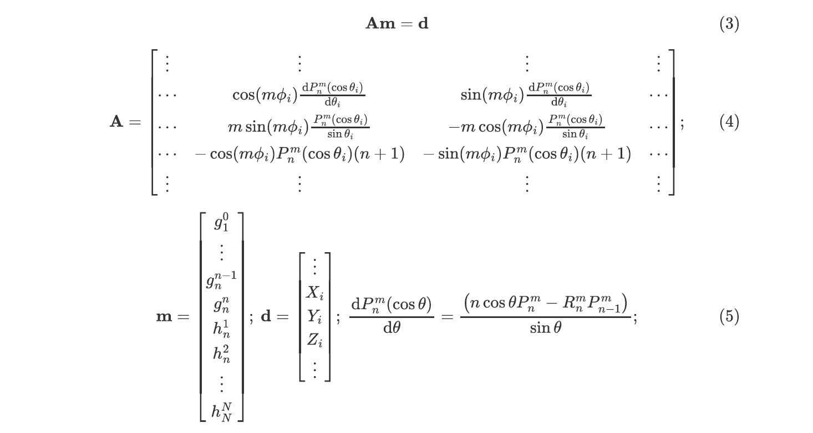
Methods and data

Slide 4
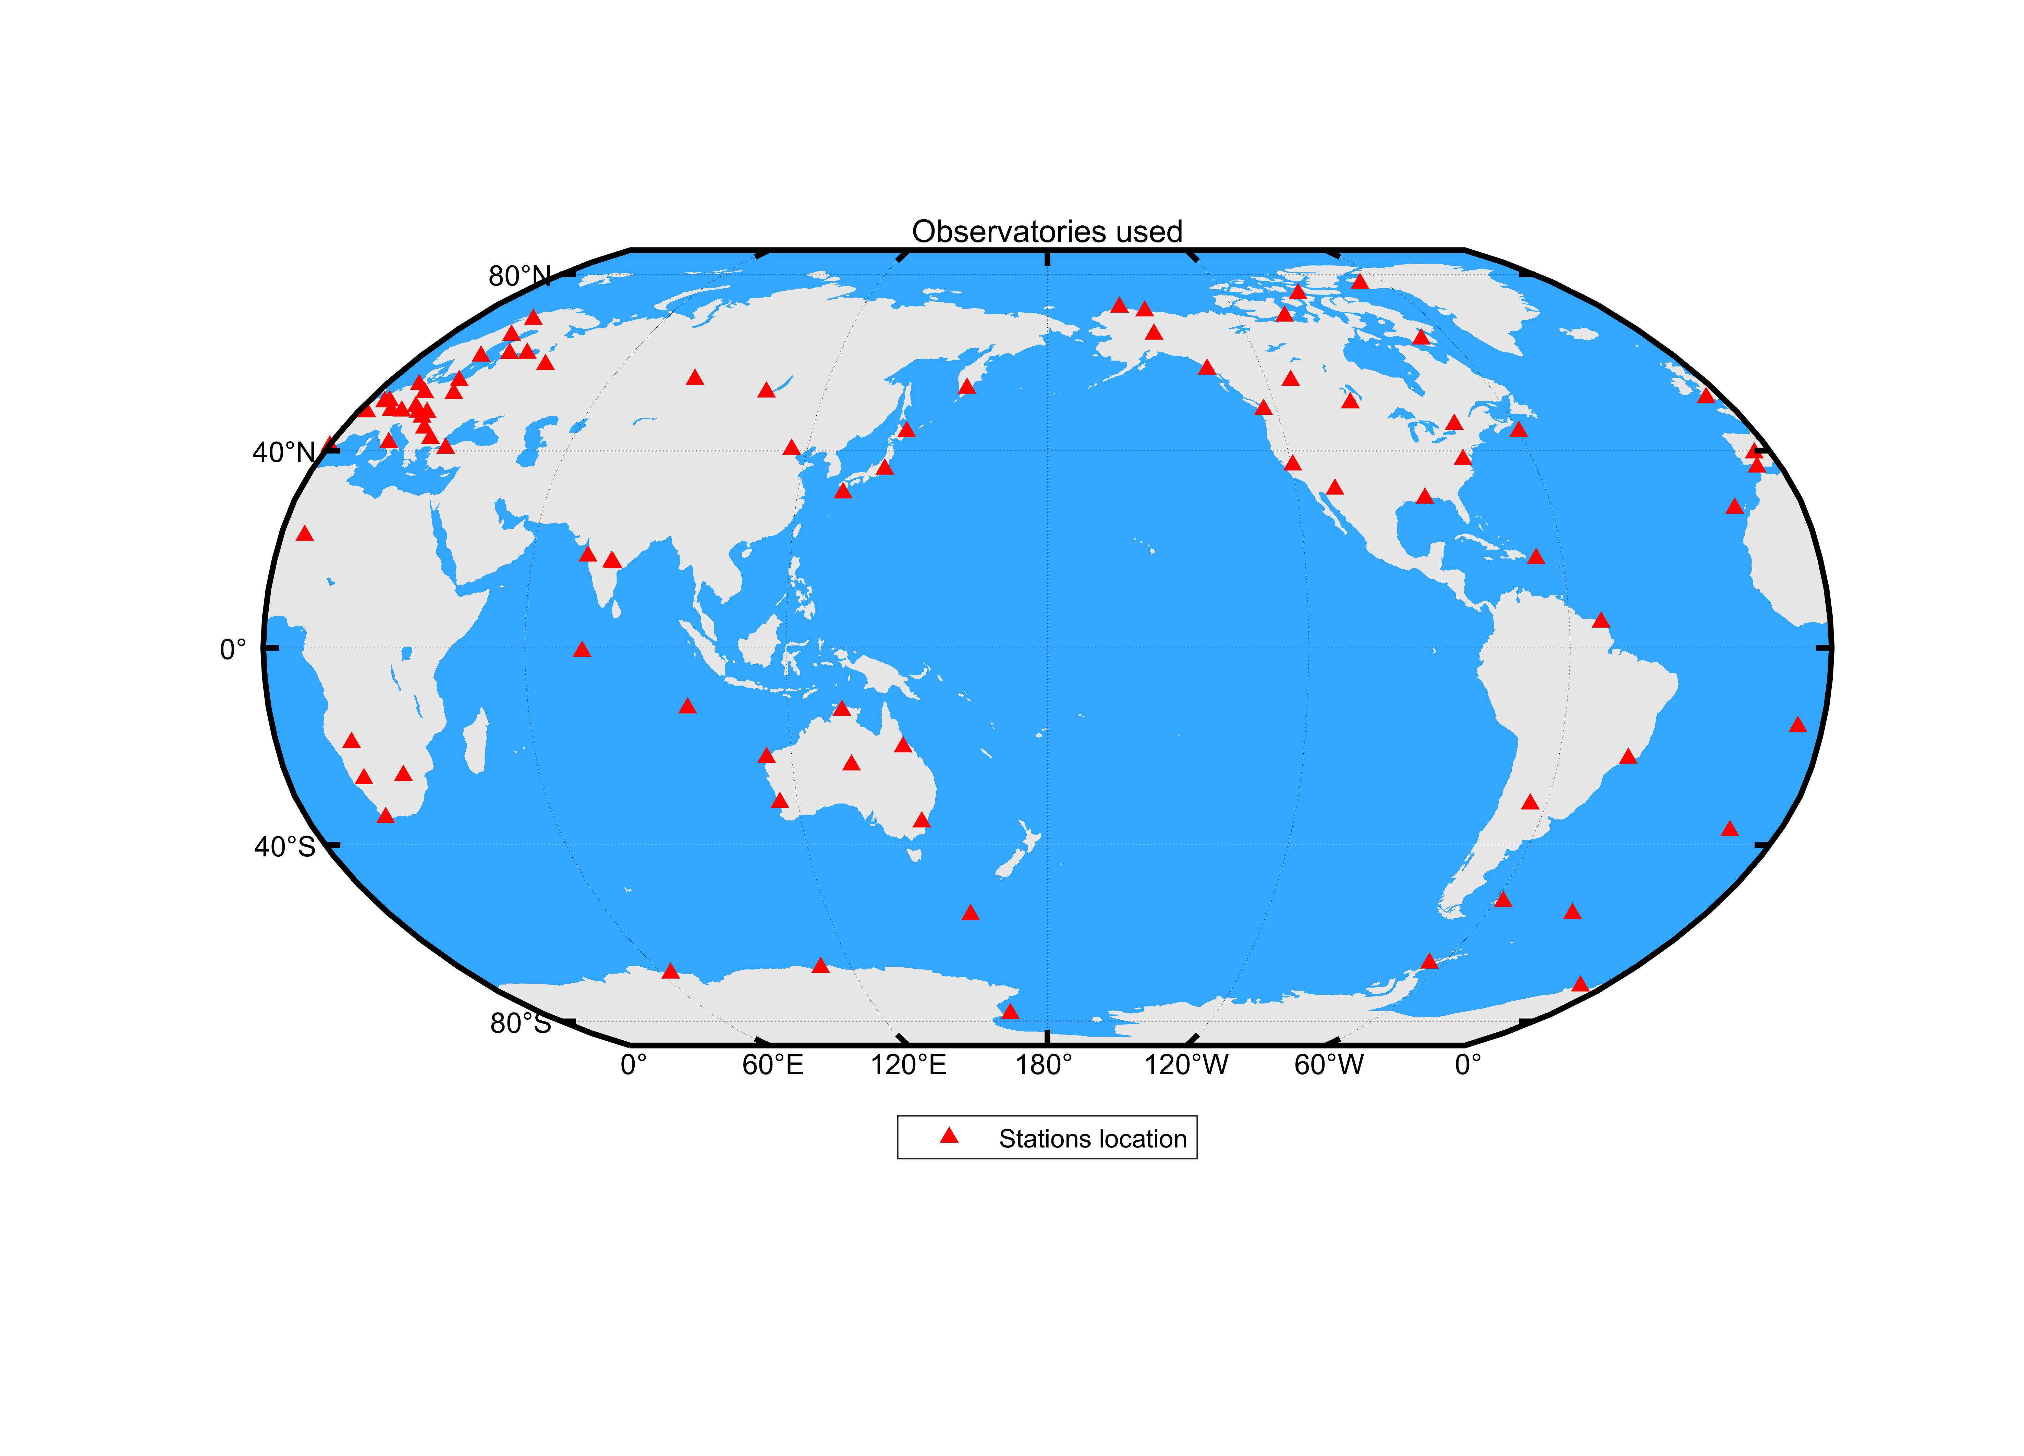
Methods and data
Definitive
Minute
2020-03-05
85-3

Slide 5
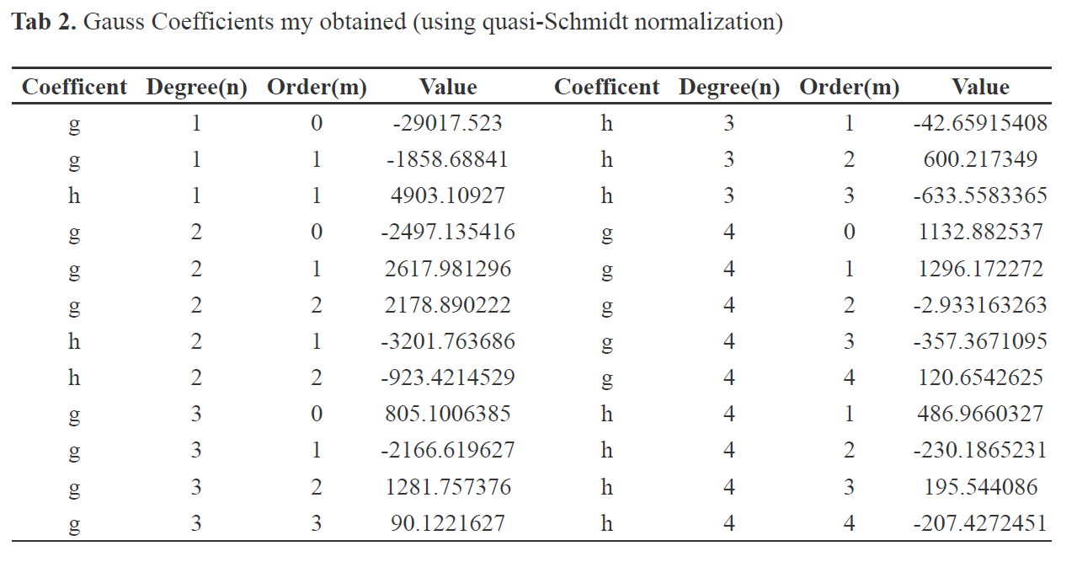
Results

Slide 6

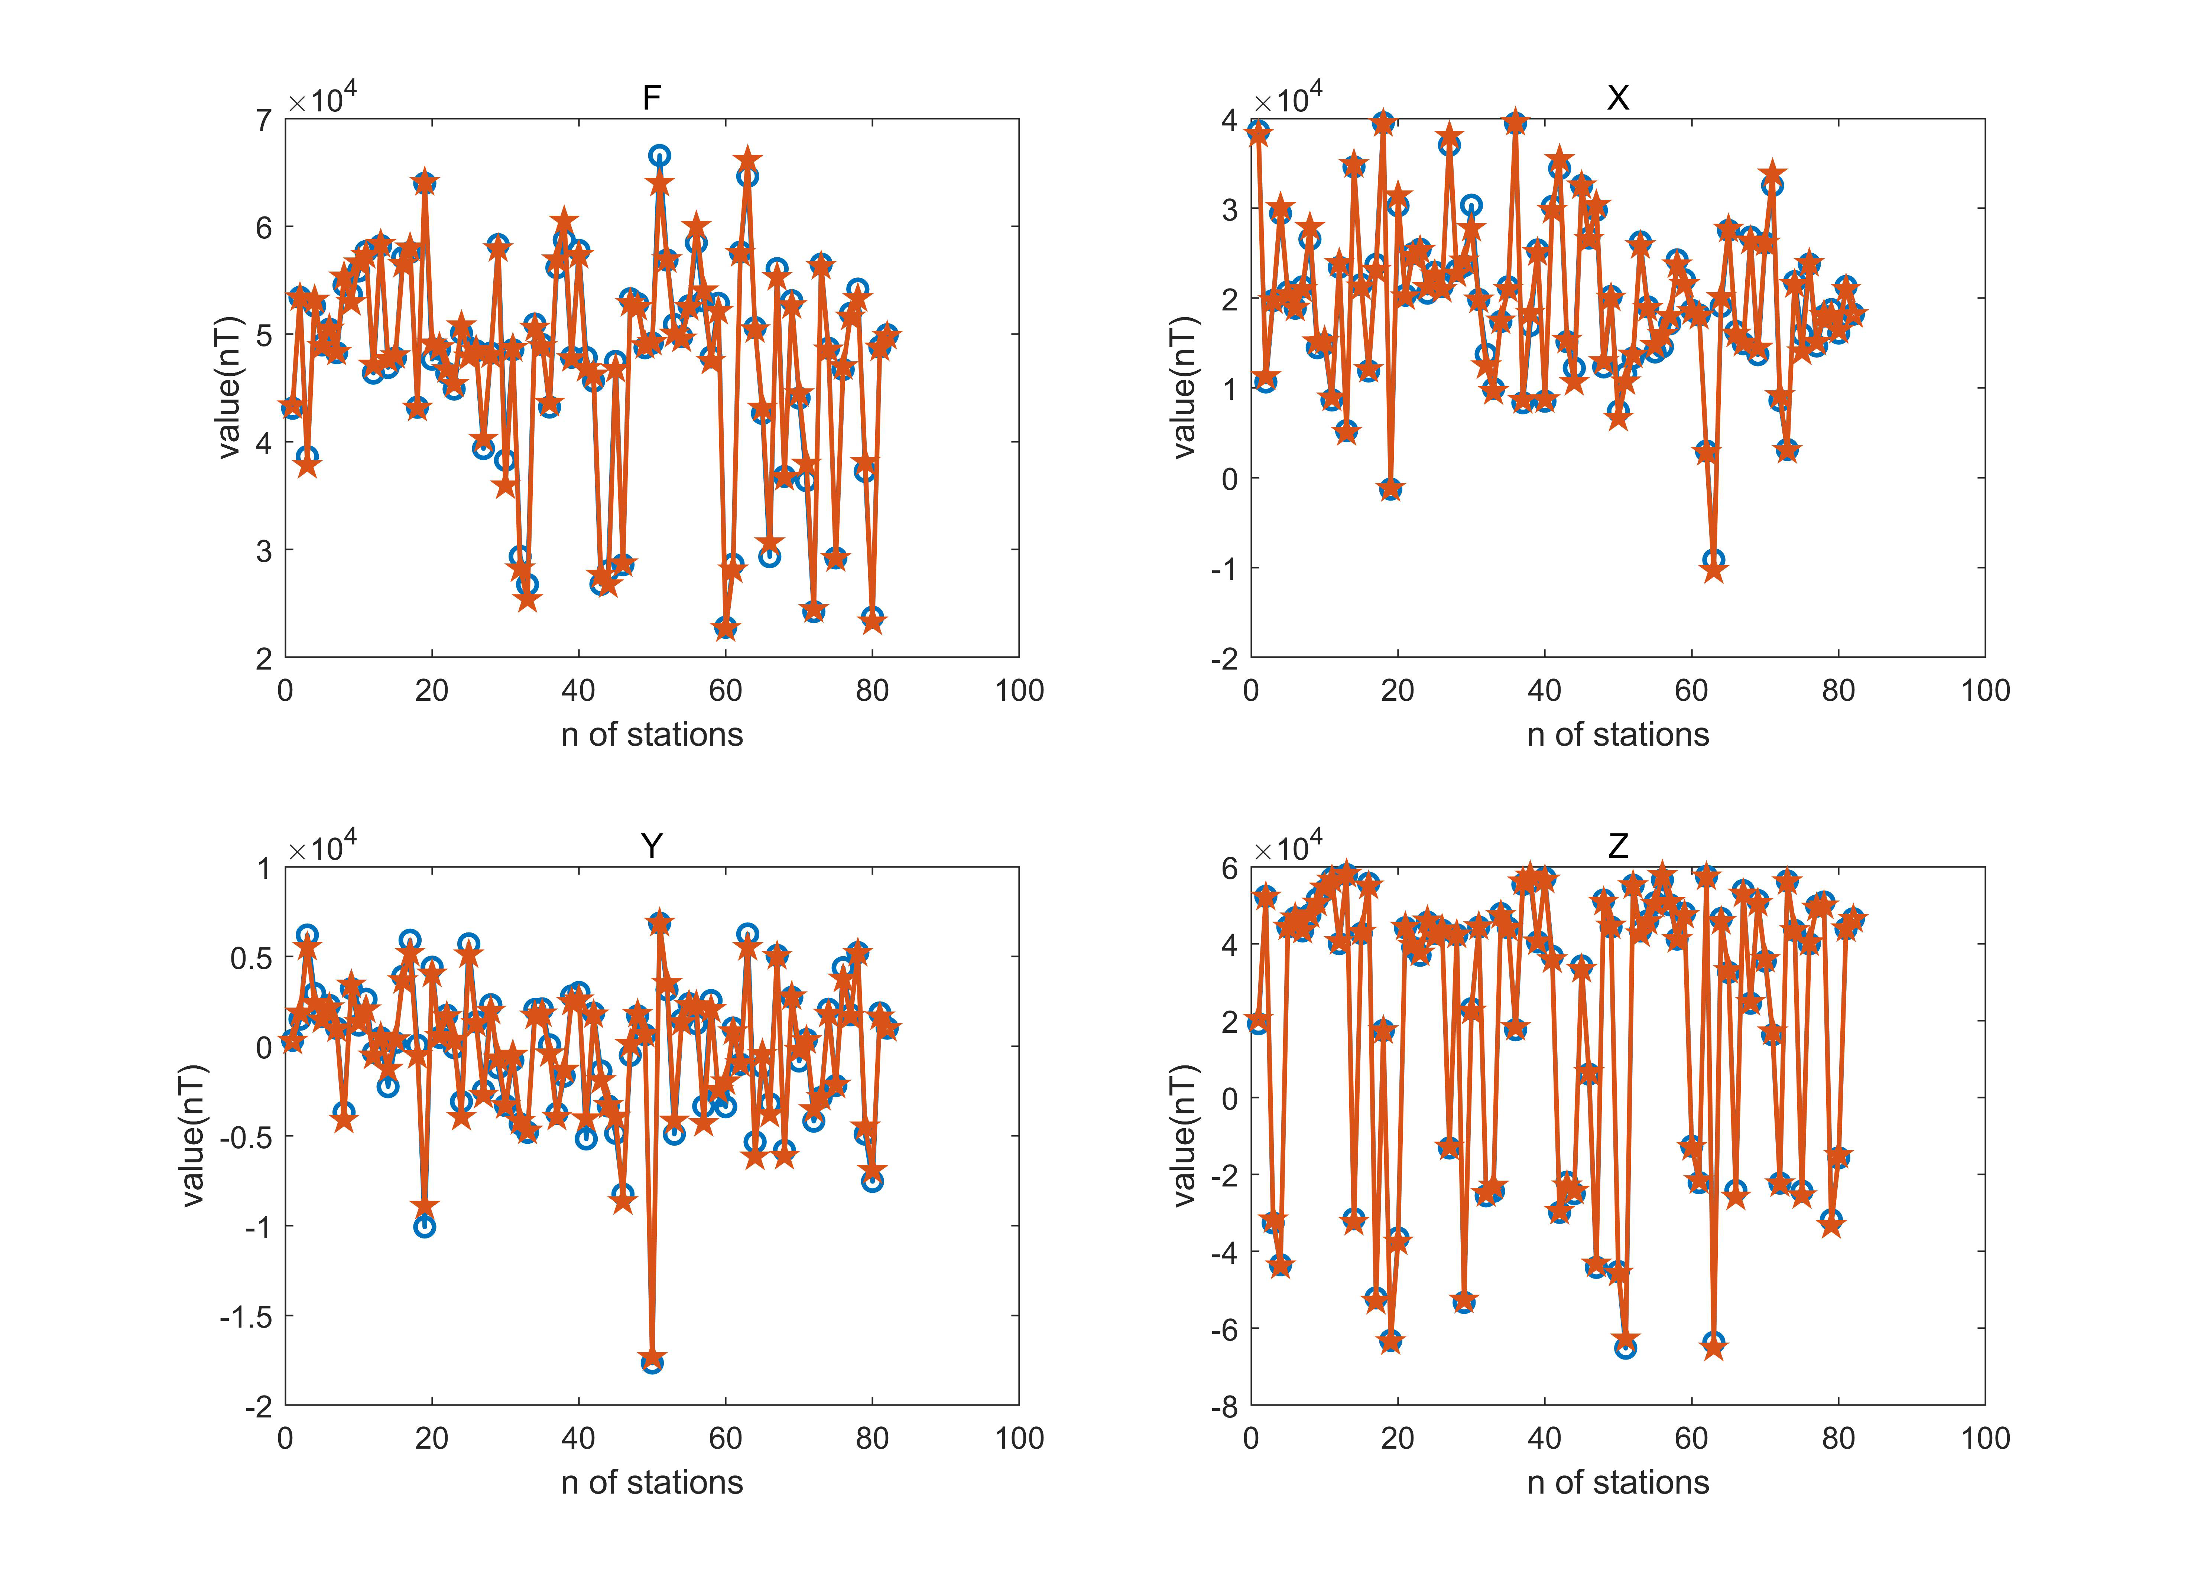
Results

Slide 7
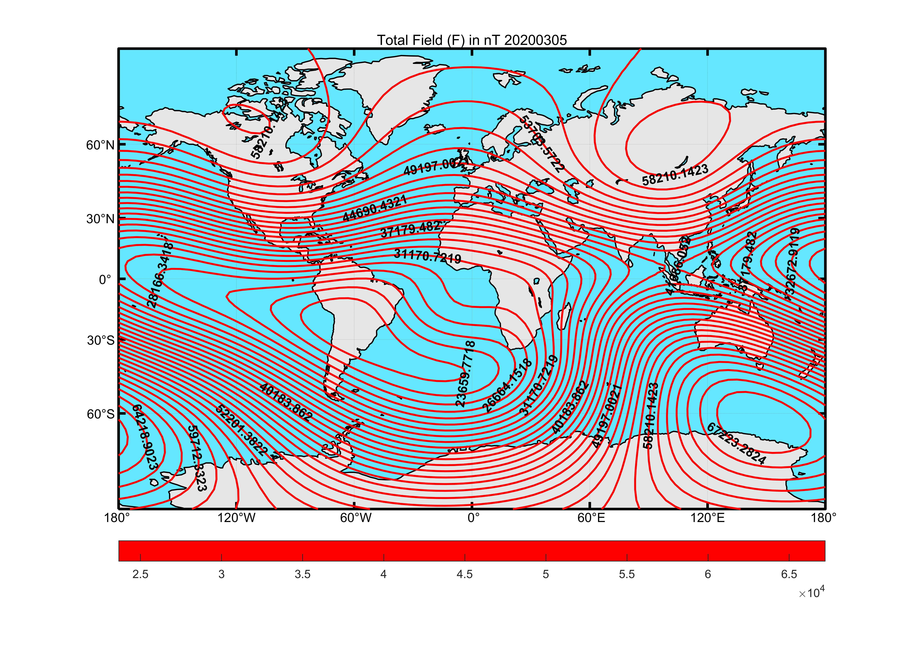
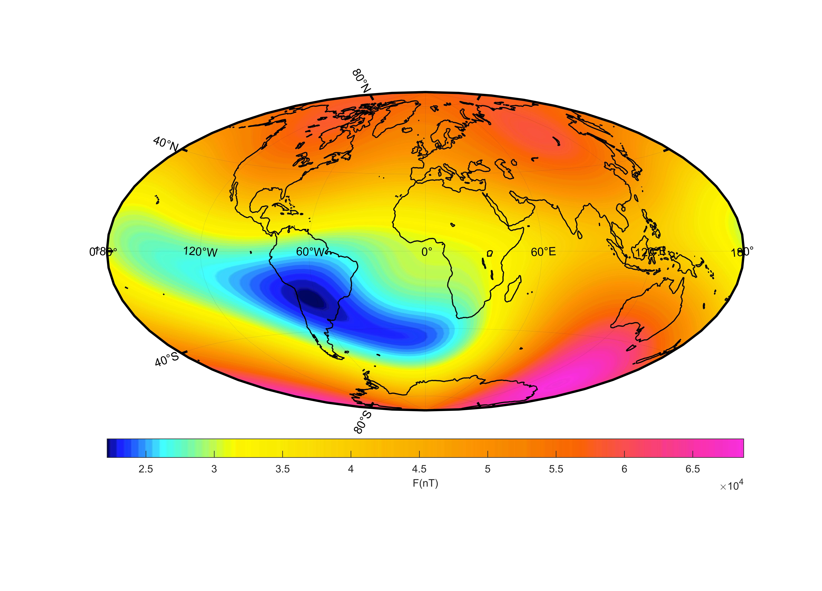
Global model-F

Slide 8
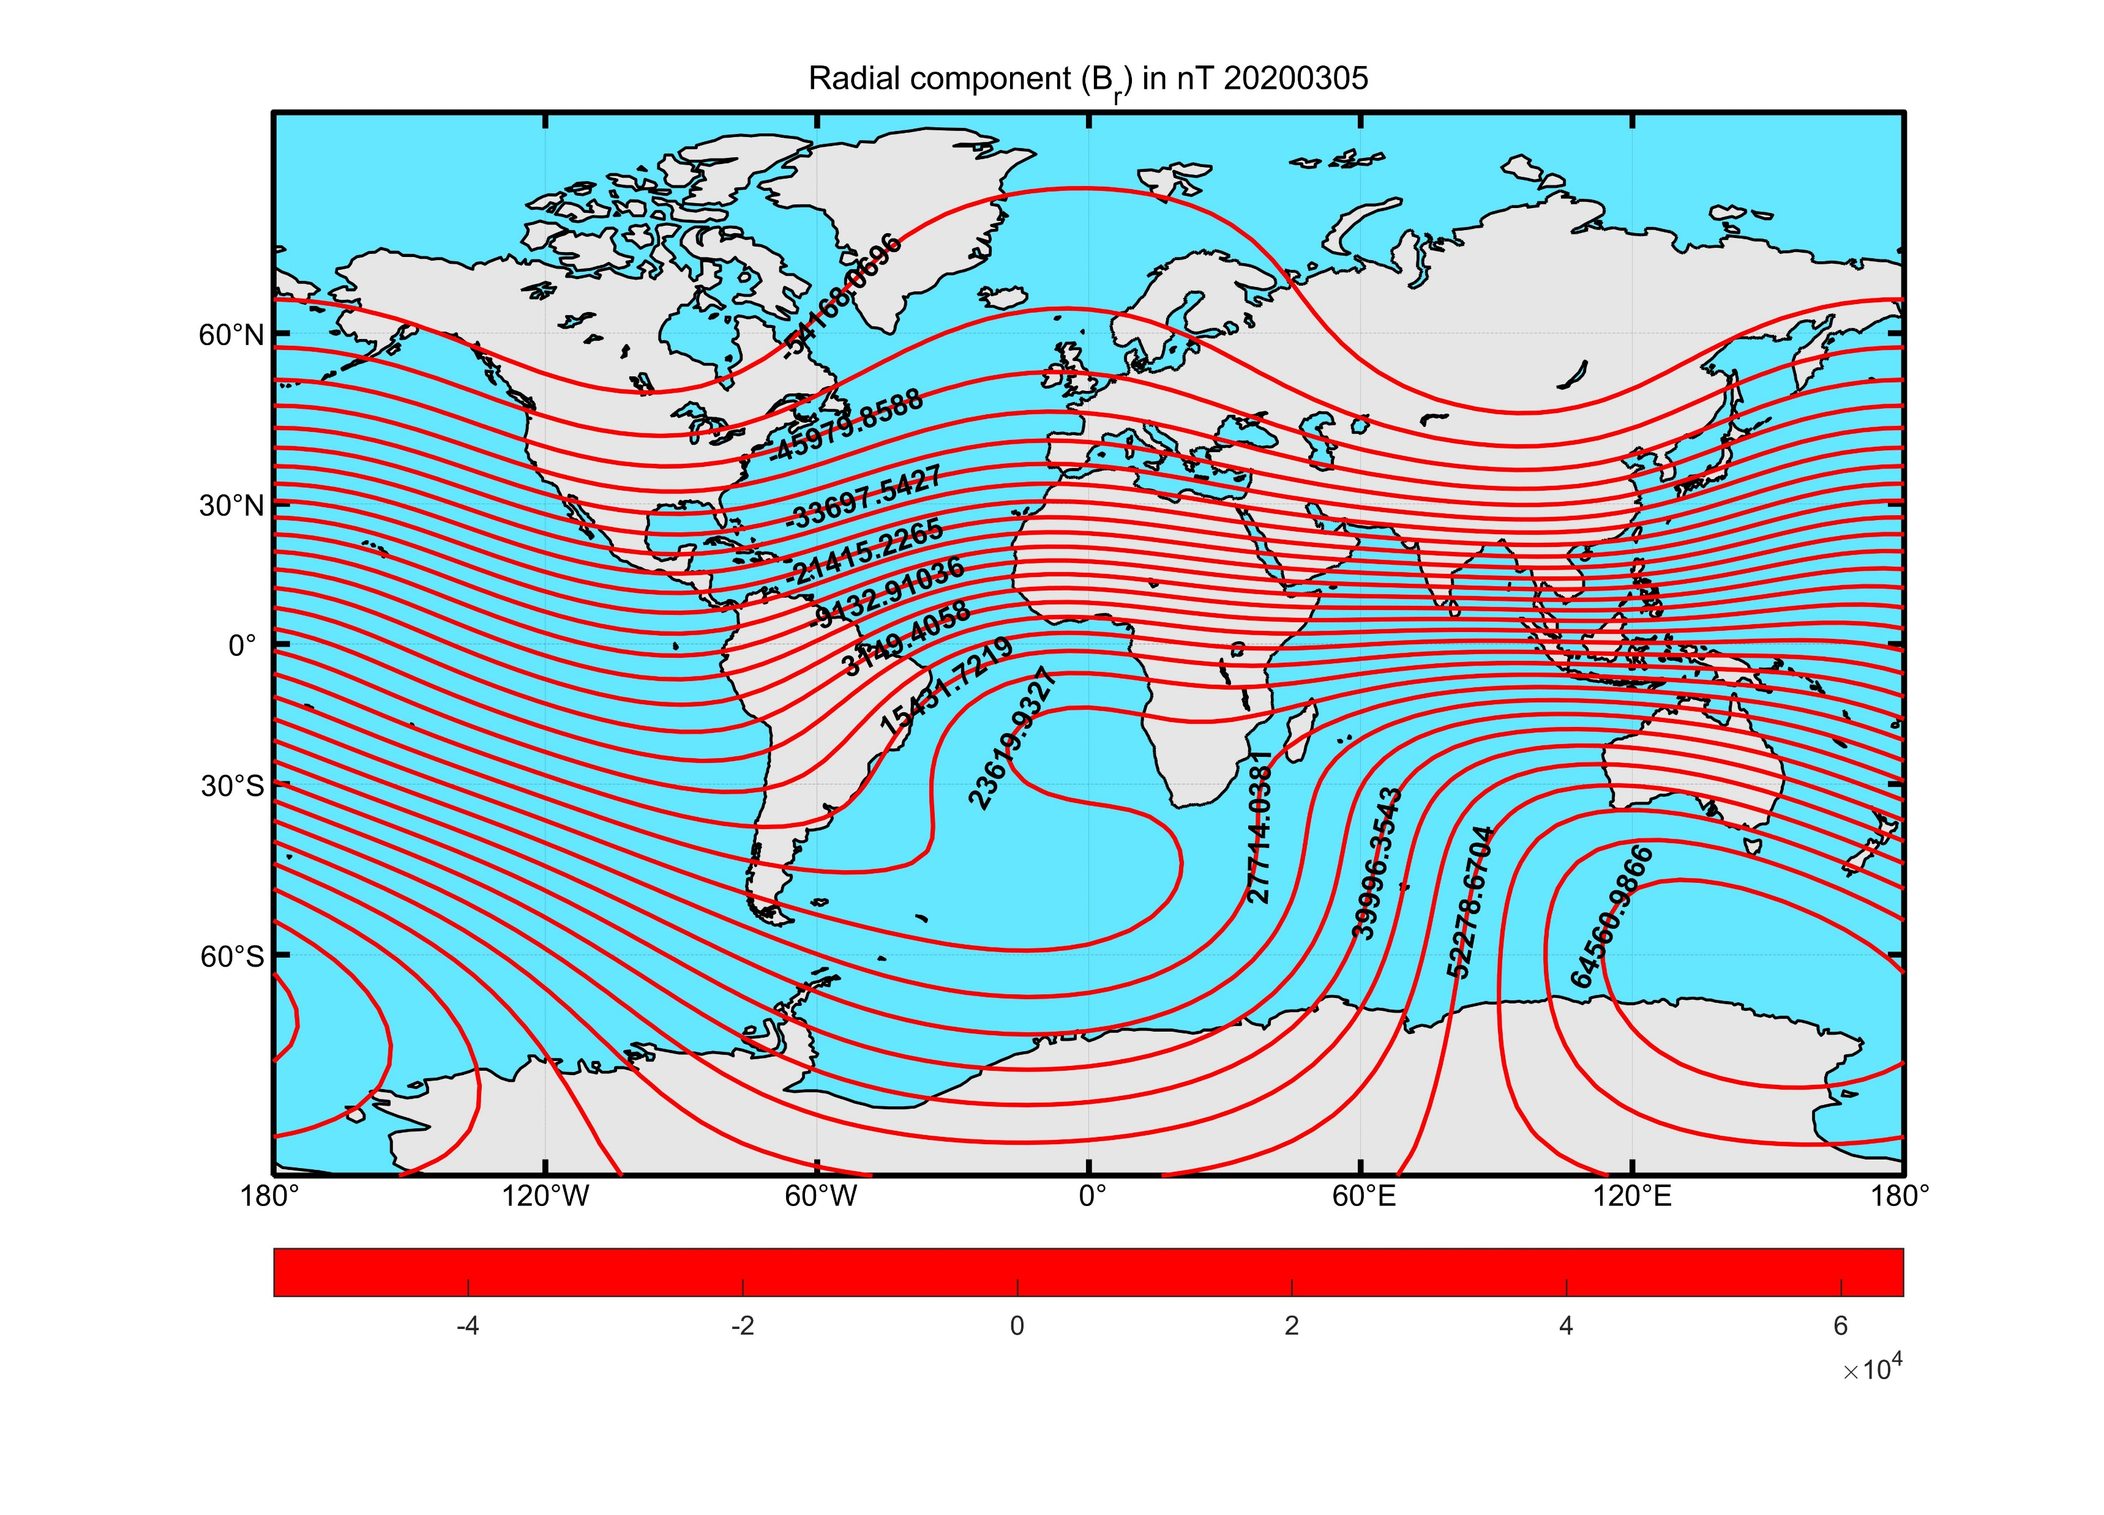
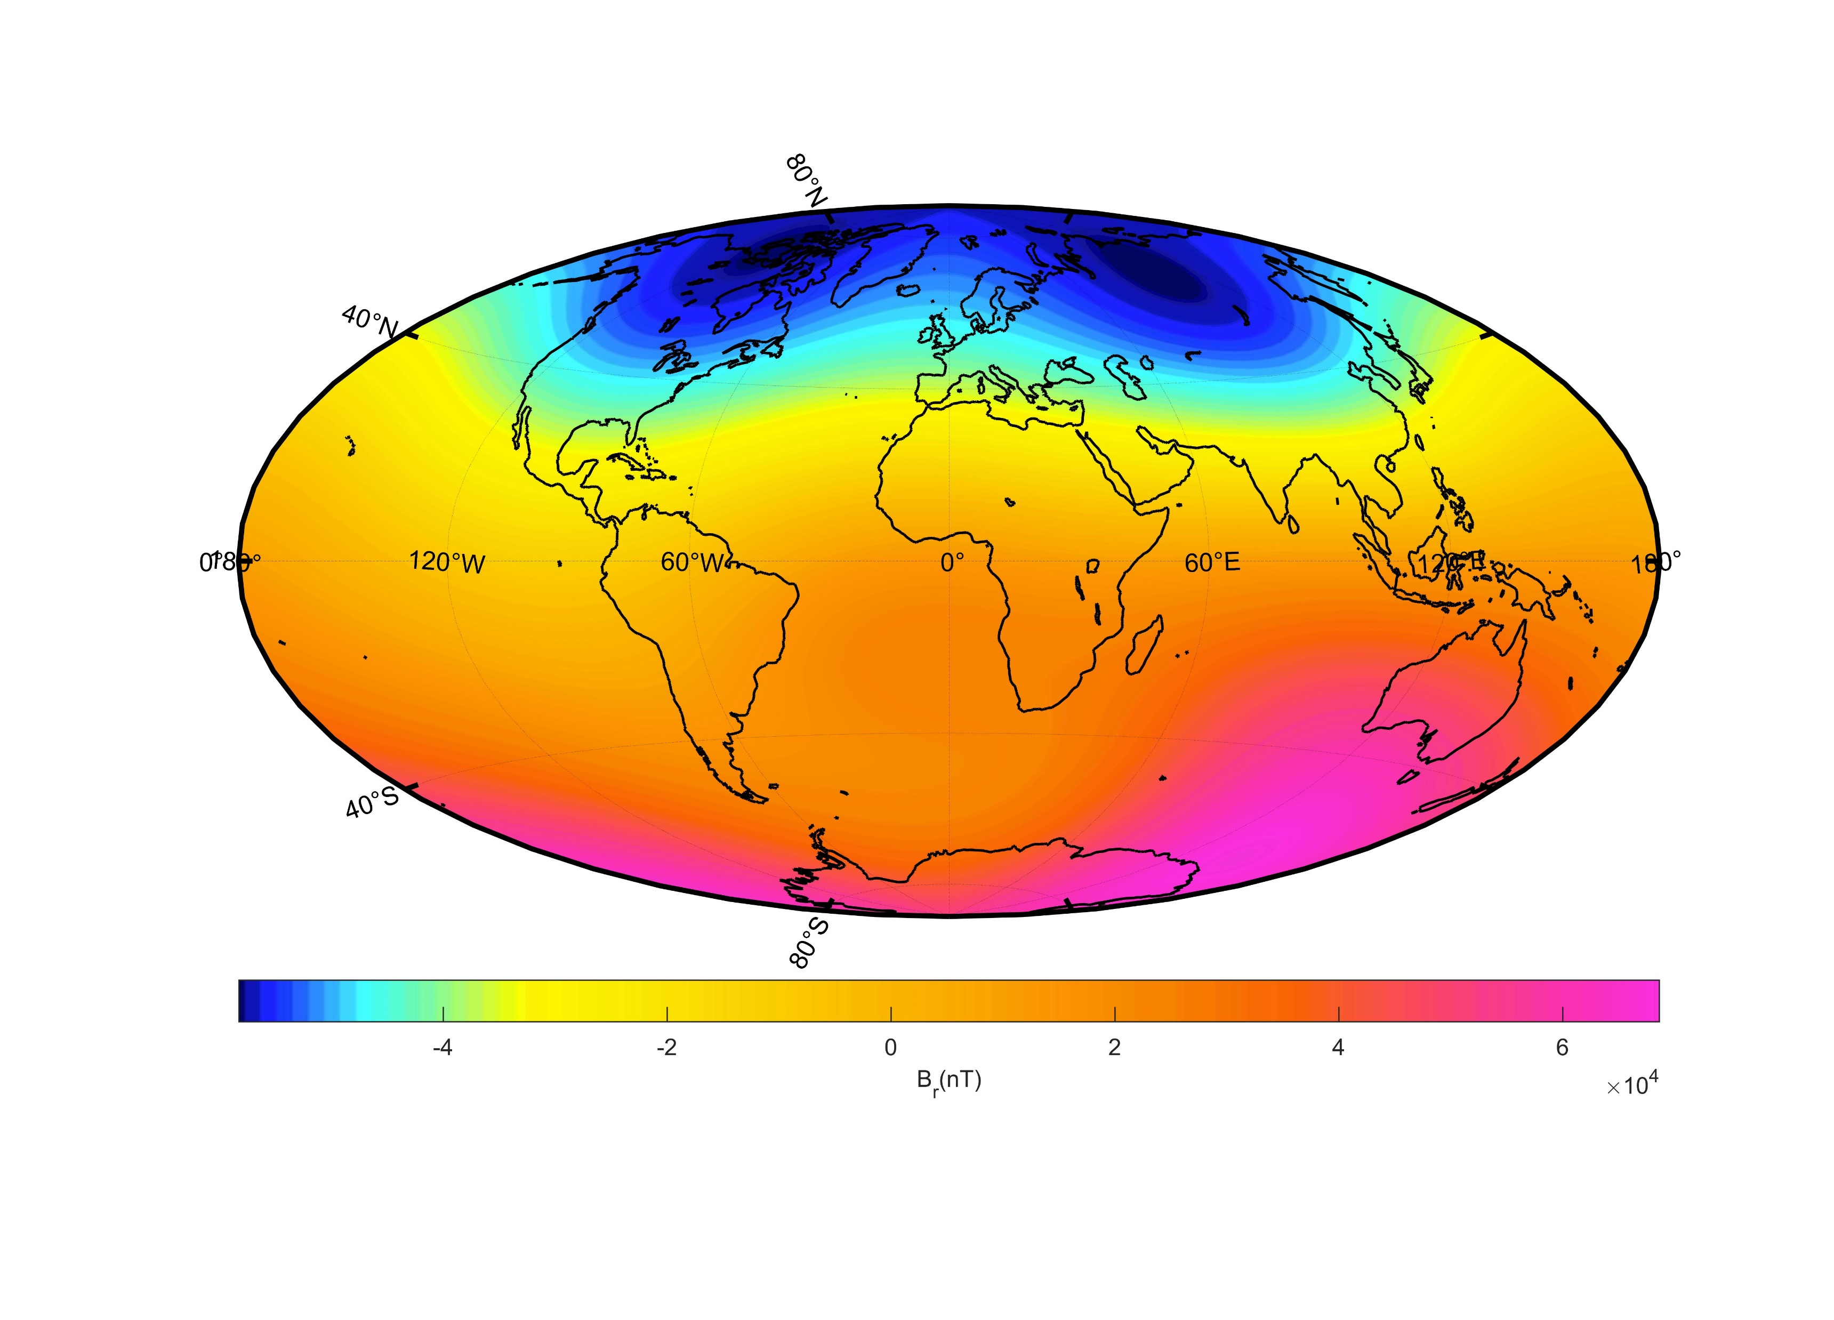
Global model-Br

Slide 9
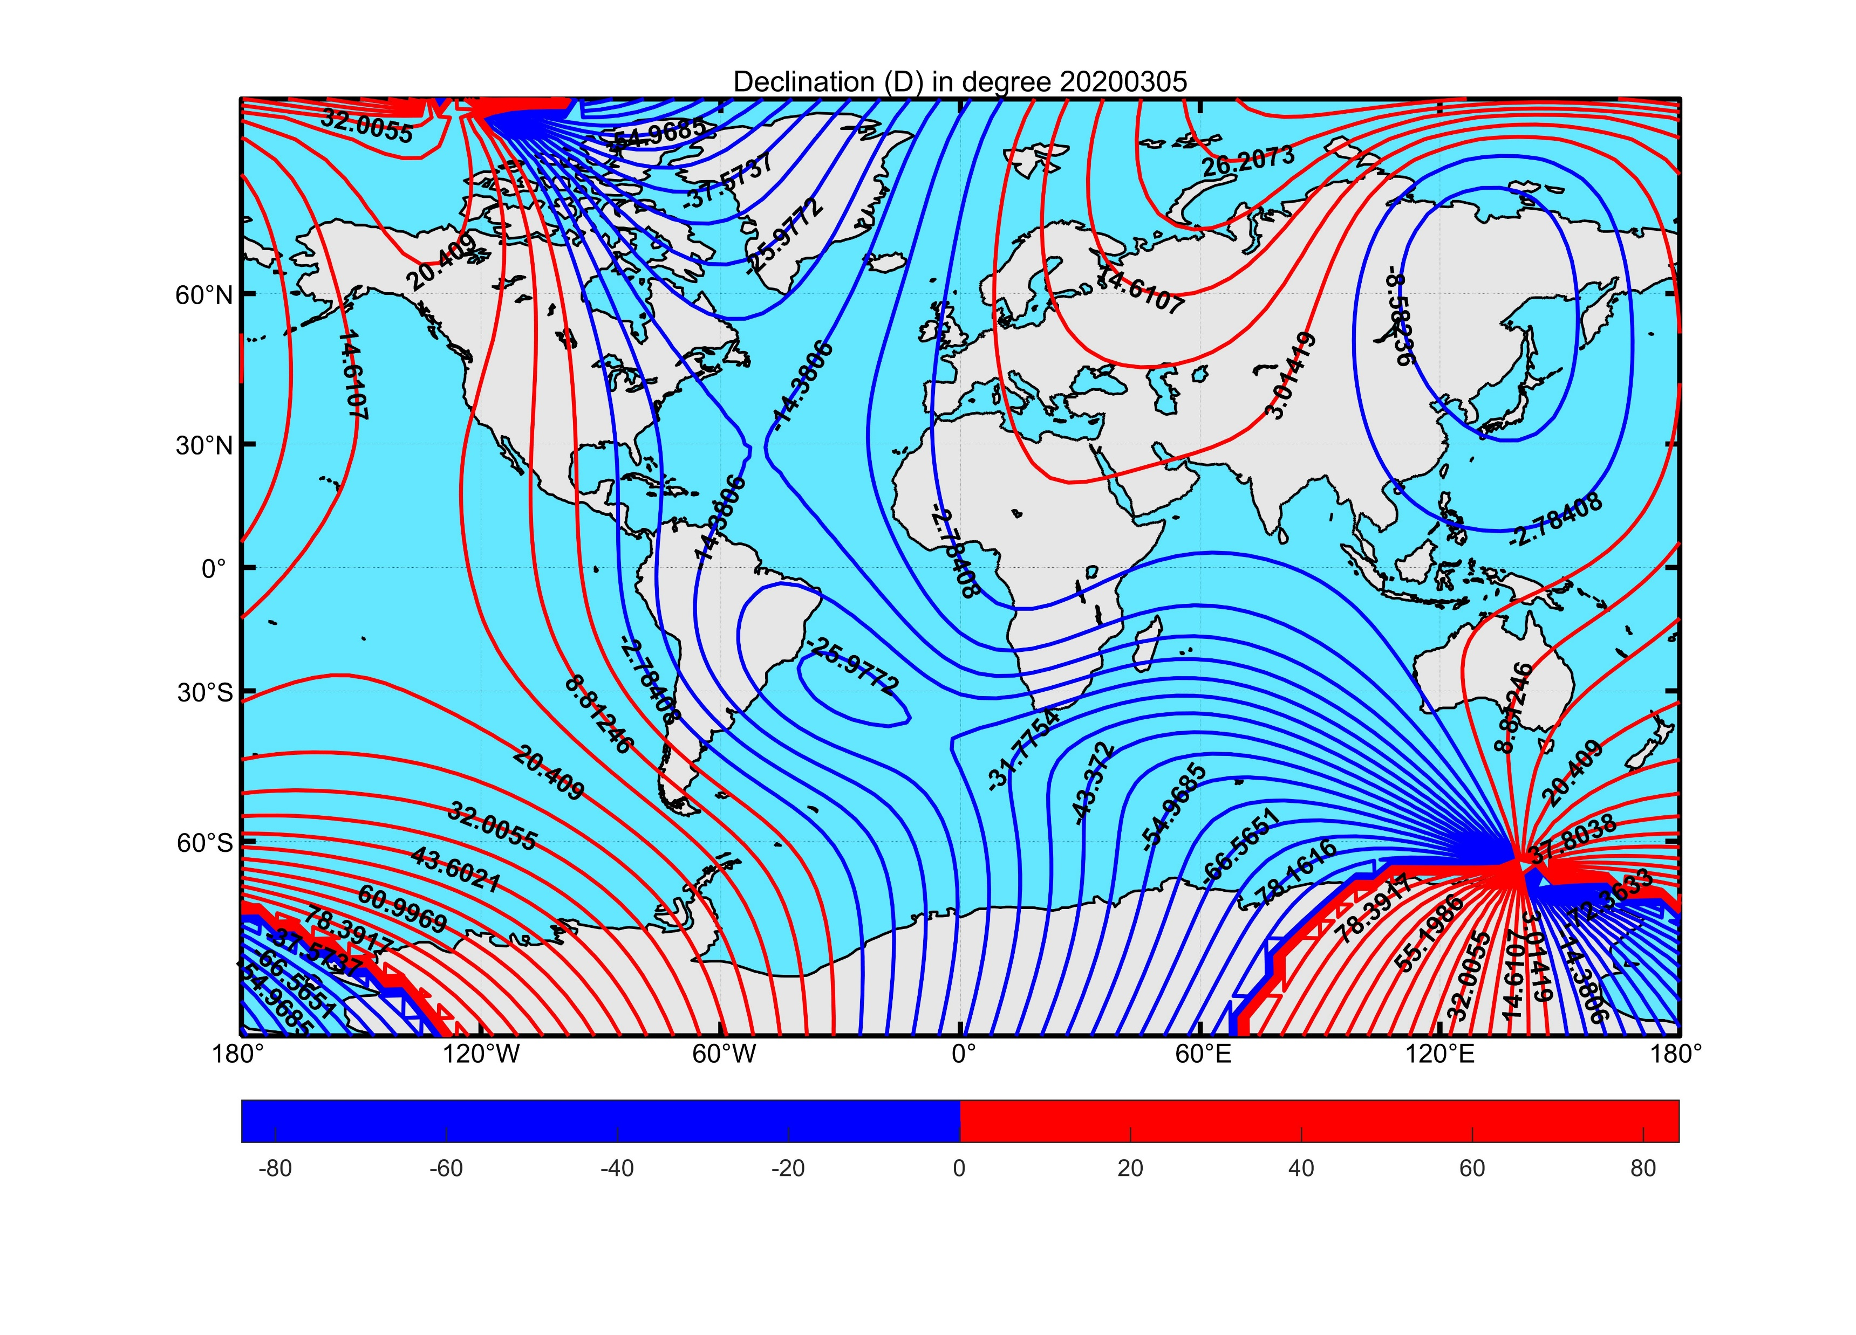
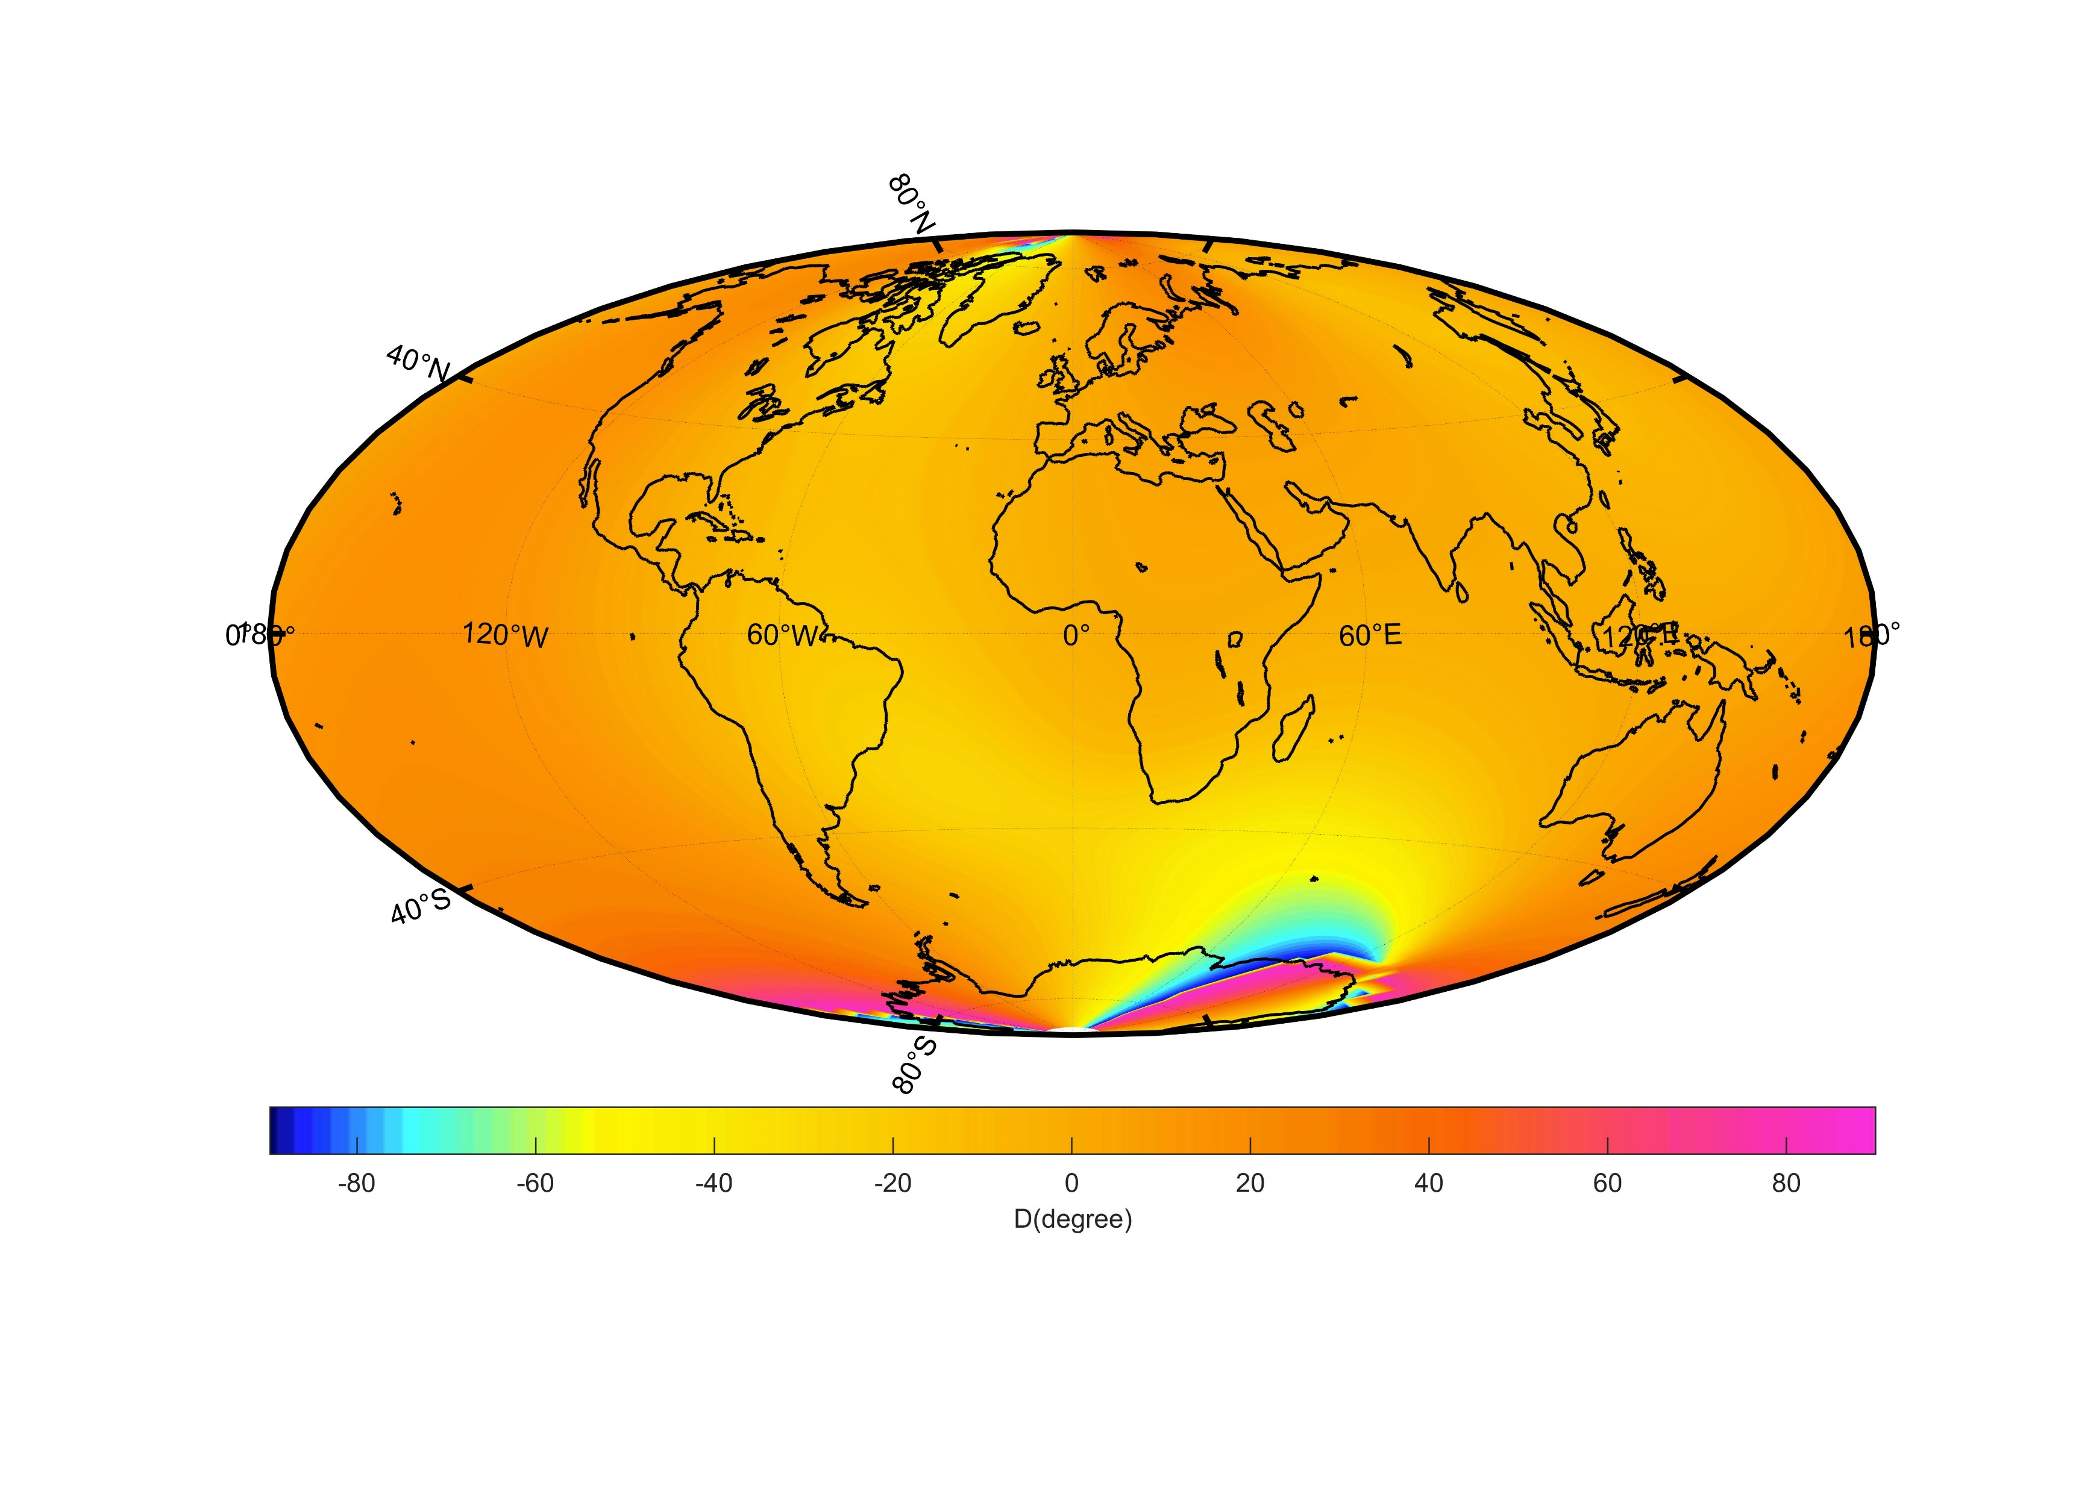
Global model-D

Slide 10
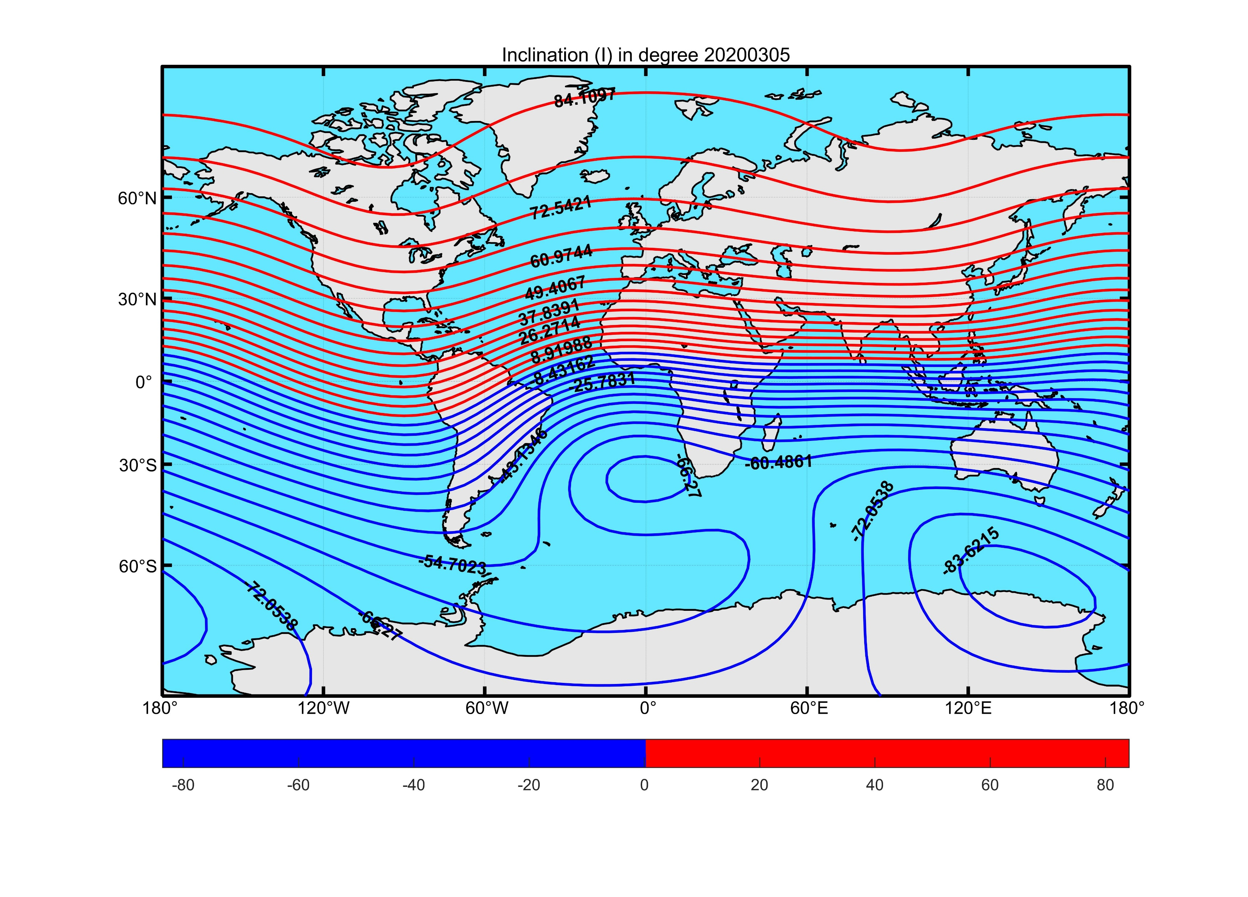
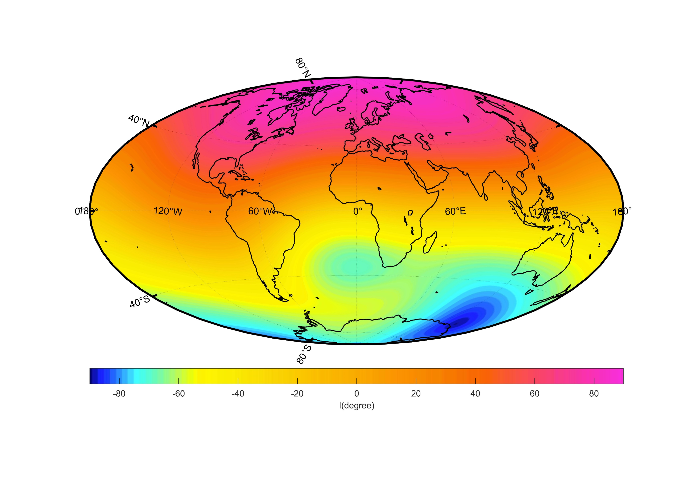
Global model-I

Slide 11
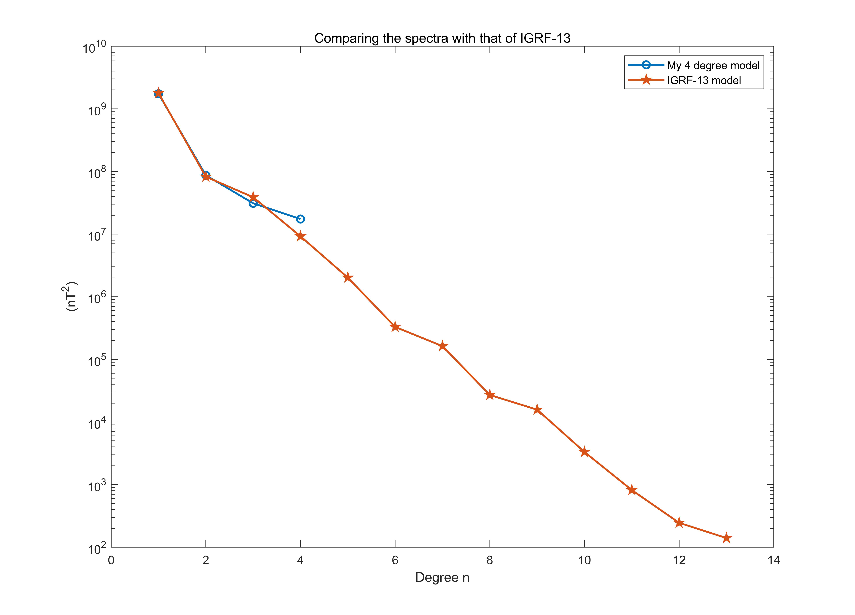
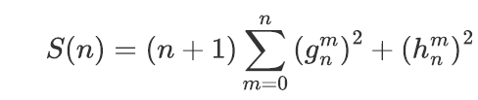
Comparison with IGRF-13

Slide 12
Discussion
Through the inversion of the observed data, I got 24 Gauss coefficients, and used them to establish the global magnetic field model, draw the magnetic field distribution on the surface of earth.
Compared with the IGRF-13 model, it has good consistency, but there are still subtle differences. The reason is that when we sift through the data, the distribution of observation stations is not well-distributed enough, and we can not achieve uniform distribution on a global scale. Therefore, the inversed model is greatly affected by the local data, even if we increase the degree of the spherical harmonic coefficient will not help, there will be even greater difference.
If our model is to be more accurate, it will need to include satellite data that can orbit the Earth around, which will also take into account the effects of external fields on the geomagnetic field, making the model more accurate.

Slide 13
Reference
THANKS
[1] 聂琳娟, 许智铭. 利用SWARM星群磁测数据反演地球主磁场模型WHU-MM01[J]. 测绘地理信息, 2020, 45(05): 16–19.
[2] 徐文耀, 区加明, 杜爱民. 地磁场全球建模和局域建模[J]. 地球物理学进展, 地球物理学进展, 2011, 26(2): 398–415.
[3] Monika Korte, Catherine Constable. Continuous global geomagnetic field models for the past 3000 years[J]. Physics of the Earth and Planetary Interiors, 2003, 140(1): 73–89.
[4] N. W. Peddie. USGS model coefficients for continental U.S. and Hawaii (1985)[J]. Planetary and Space Science, 1992, 40(4): 561.
[5] An Homage to Gauss and His Model of the Earth’s Magnetic Field[J]. CMS Notes, .
[6] Davis J. Mathematical Modeling of Earth’s Magnetic Field[J]. .
[7] 白春华, 徐文耀, 康国发. 地球主磁场模型[J]. 地球物理学进展, 2008(4): 1045–1057.
[8] 冯春. Matlab实现IGRF国际地磁参考场模型的计算[J]. 内蒙古石油化工, 2014, 40(12): 43–46.
[9] 安振昌. 地磁场区域模型与全球模型的比较和讨论[J]. 物探与化探, 1991(04): 248–254.
[10] 刘元元, 王仕成, 张金生, 等. 最新国际地磁参考场模型IGRF11研究[J]. 地震学报, 2013, 35(1): 125-131+133-134+138.
[11] International Geomagnetic Reference Field (IGRF-13)[EB/OL]. /2022-05-28. https://wdc.kugi.kyoto-u.ac.jp/igrf/index.html.
[12] Alken P, Thébault E, Beggan C D, 等. International Geomagnetic Reference Field: the thirteenth generation[J]. Earth, Planets and Space, 2021, 73(1): 49.
[13] Finlay C C, Kloss C, Olsen N, 等. The CHAOS-7 geomagnetic field model and observed changes in the South Atlantic Anomaly[J]. Earth, Planets and Space, 2020, 72(1): 156.

Slide 14
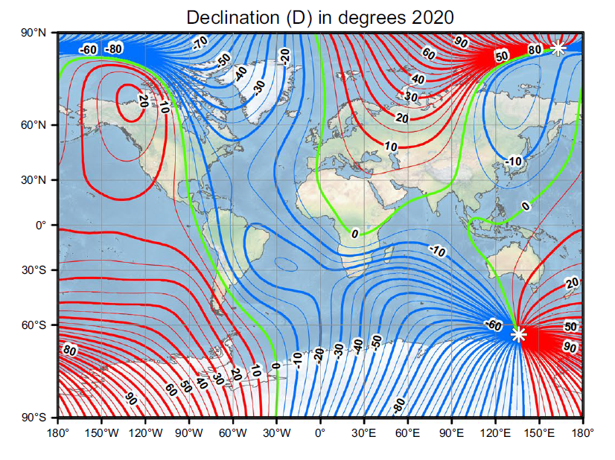
IGRF-13-D

Slide 15
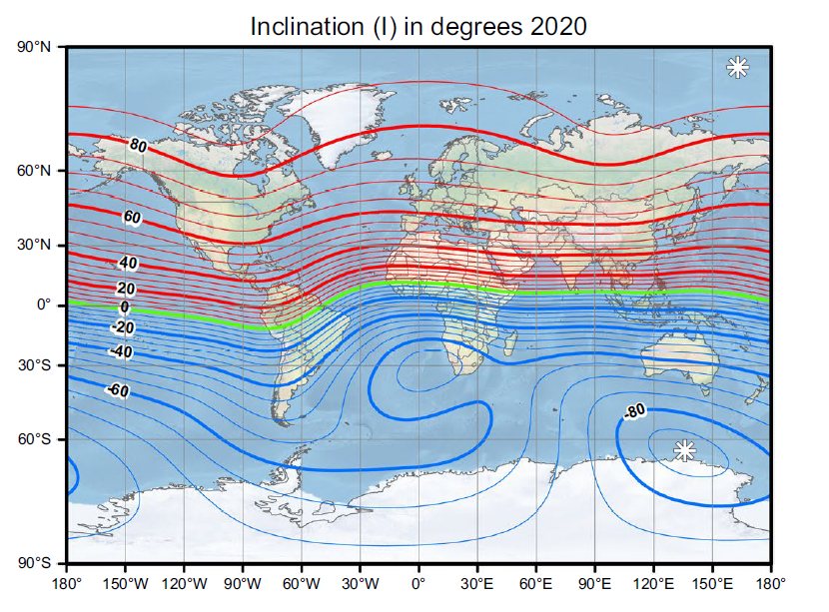
IGRF-13-I

Slide 16
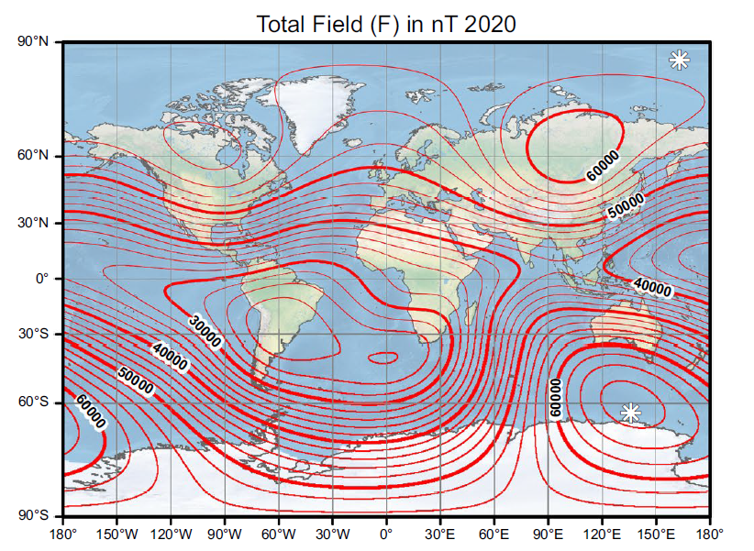
IGRF-13-F

Slide 17
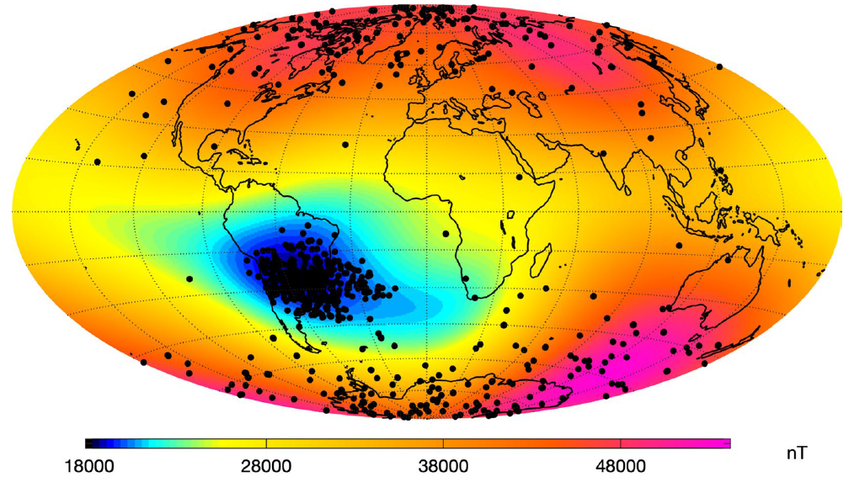
CHAOS-7

